Slide 1
Handwritten digits recognition system
Presented by:-
Anusha Dasari : A20471583
Chirag Prakash: A20468201
Vinjal doshi : A20473398

Slide 2
abstract
Handwritten digit recognition helps us to identify the digits which are handwritten.
We have trained our model using the MNIST dataset
We have used several models to for training and testing, thus formed a conclusion based on the highest accuracy provided from which model.

Slide 3
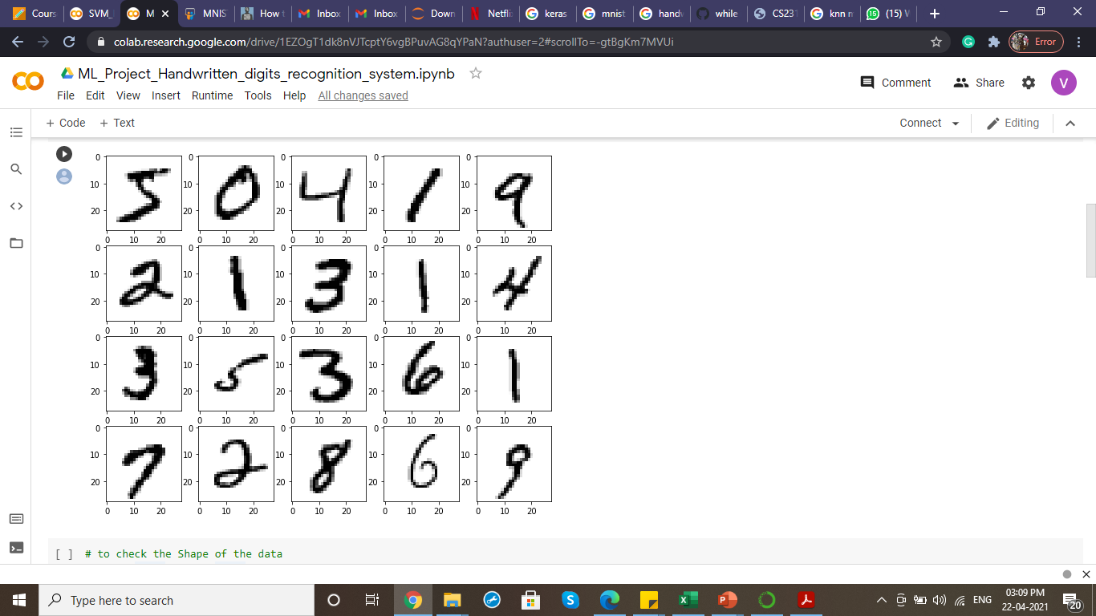
About the dataset (mnist dataset)
This dataset is one of the classic dataset with so many handwritten digit images in it.
There are 10 digits or 10 classes to predict.
There are about 60000 small grayscale image of 28*28 pixel size with one handwritten digit on it.

Slide 4
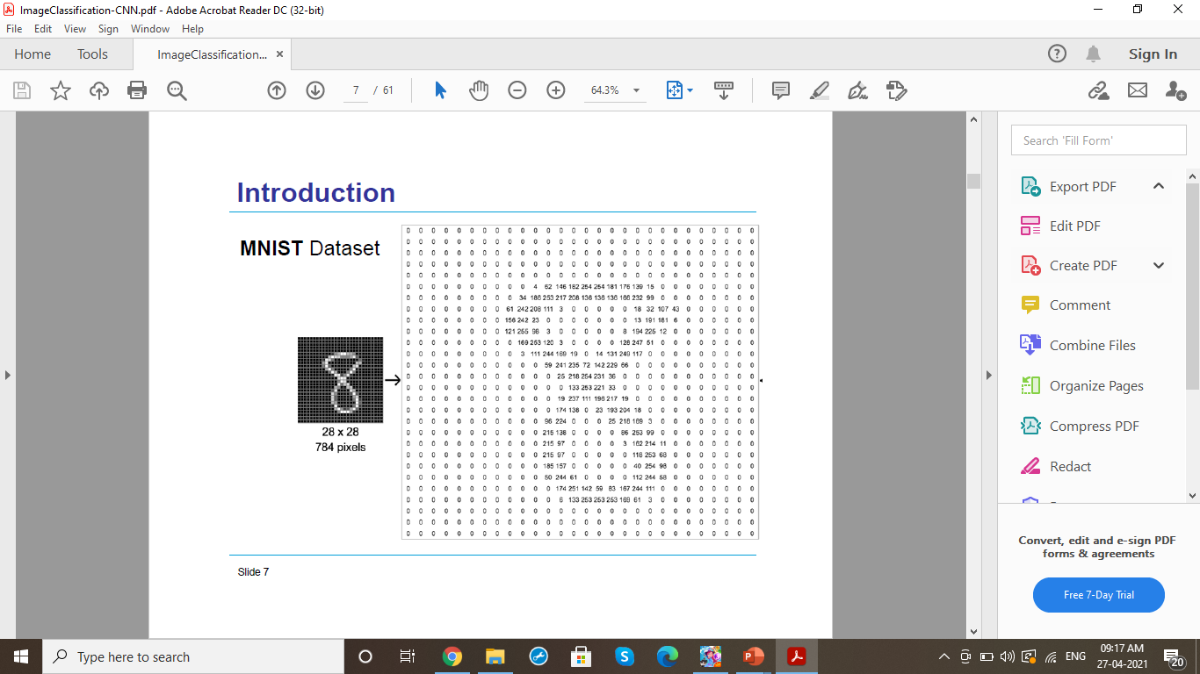
About the dataset (mnist dataset)
Every image can be thought of as in array of numbers between 0 and 255 describing how dark a pixel is supposed to be.

Slide 5
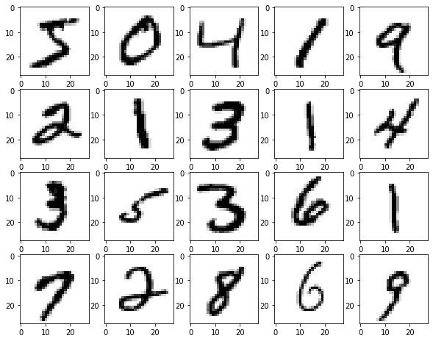
About the dataset (mnist dataset)
Every MNIST dataset has two parts:
Image of handwritten digit
Corresponding label representing the digit drawn in the image
That label helps us to compare the predicted digit and true digit drawn

Slide 6
Deep learning
Deep-learning networks are distinguished from the more common single-hiddenlayer neural networks by their depth
More than three layers (including input and output) qualifies as “deep” learning
In deep-learning networks, each layer of nodes trains on a distinct set of features based on the previous layer’s output
The further you advance into the neural net, the more complex the features your nodes can recognize, since they aggregate and recombine features from the previous layer

Slide 7
Convolutional neural network
CNNs take a biological inspiration from the visual cortex
The visual cortex has small regions of cells that are sensitive to specific regions of the visual field
Having the neuronal cells in the visual cortex looking for specific characteristics is the basis behind CNNs

Slide 8
Convolutional neural network
Network Architecture
• Convolutional Layer, Pooling Layer, Fully Connected Layer

Slide 9
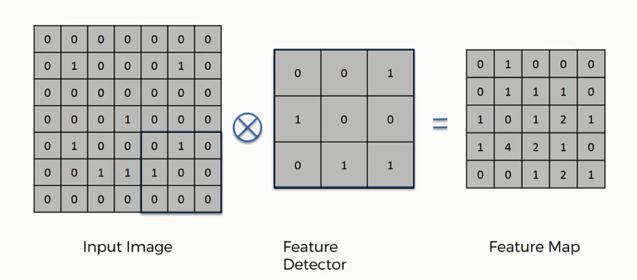
Convolution operation
The 3×3 matrix (K) is called a ‘filter‘ or ‘kernel’ or ‘feature detector’ and the matrix formed by sliding the filter over the image and computing the dot product is called the ‘Convolved Feature’ or ‘Activation Map’ or the ‘Feature Map‘.

Slide 10
Activation layer
An additional operation called Rectified Linear Unit (ReLU) has been used after every Convolution operation
Basically, ReLU is an element wise operation (applied per pixel) and replaces all negative pixel values in the feature map by zero
The purpose of ReLU is to introduce non-linearity to the network

Slide 11
Pooling layer
Pooling layer downsamples the volume spatially, independently in each depth slice of the input
The most common downsampling operation is max, giving rise to maxpooling.

Slide 12
Fully Connected Layer
Neurons in a fully connected layer have full connections to all activations in the previous layer, as seen in regular neural networks

Slide 13
Process
Input
Feature Representation
Label
Import the libraries and load the dataset
Preprocess the data
Create the model
Train and Evaluate the Model
Saving the model
Make Predictions

Slide 14
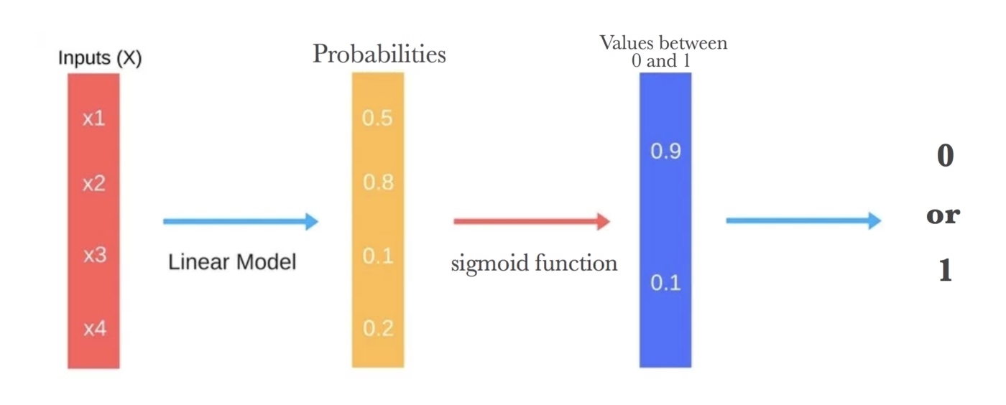
Logistic regression
It is very similar to linear regression
It helps us in the process of classification
It is a supervised learning classification method

Slide 15

SVM (Support vector machine)
SVMs are based on finding hyperplane that best divides the data into classes
The further from the hyperplane our data points lie, the more confident we are that they have been correctly classified
It provides us the results with accuracy
SVM works well on cleaner dataset
It can be very efficient since it uses a subset of training points

Slide 16
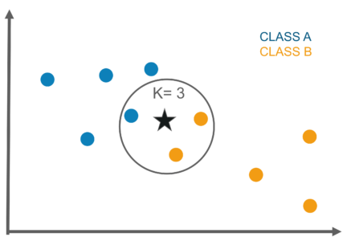
KNN (k- nearest neighbours)
KNN assume that the similar things are always near to each other and it follows that approach
It classifies the new data based on similarity
Here K is the number of neighbours.

Slide 17
Convolutional neural Network
Convolutional neural network are similar to any neural network, it contains weights and biases.
The difference here is that it assumes the input is always a image which results in reduction of various number of parameters in the network
They provide better feature extraction

Slide 18
Calculation of accuracy
Algorithm | Accuracy
Logistic regression | 91%
SVM | 97.34%
KNN | 97%
Convolution Neural Network | 99.04%

Slide 19
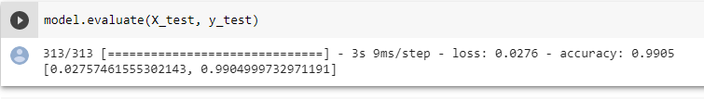
conclusion
The best approach for the MNIST is CNN since it has shown the most accuracy of about of 99%

Slide 20
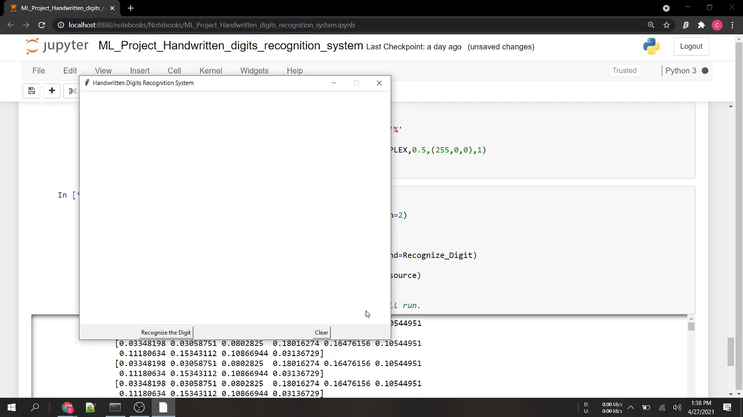
Here is a little demo of our project

Slide 21
Thank you

